Slide 1

Electric load forecasting
Submitted By:
Neeraj Kumawat (222IT024)
Abhishek Yadav (222IT003)
Deepak Yadav (222IT009)
Under Guidance of : Dr. Biju R. Mohan

Slide 2
Introduction
Forecasting is the problem of determining the future values of a time series from the current and past values.
Load forecasting is about estimating future consumptions based on various data and information available as per consumer behaviour.
Load Forecasting can help to estimate the load flows and to make decisions that can prevent overloading. Timely implementations of such decisions lead to improvement of network reliability and to reduced occurrences of equipment failures or blackout.
Electric Load Forecasting is the estimation of the required load in the future.

Slide 3
Problem Statement
The goal is to develop a reliable and accurate model that can be used by energy providers to plan and optimize their operations, ensure adequate supply, and avoid overloading the electrical grid. This problem is important because accurate load forecasting can lead to significant cost savings, increased efficiency, and improved reliability of the power system. However, this is a challenging task due to the complexity and volatility of the electricity market, as well as the influence of various external factors on electricity consumption.

Slide 4
Literature Survey
Authors | Year | summary
"Electric Load Forecasting using Statistical Techniques: A Survey" by S. Mishra et al. | 2018 | This paper covers traditional methods such as ARIMA and exponential smoothing, as well as newer techniques such as wavelet analysis and support vector regression. The authors compare the accuracy of different methods using real-world data and highlight the strengths and weaknesses of each approach.
"Electric Load Forecasting: A Review of the Literature and Future Research Directions" by M. H. Gheisari et al. | 2019 | This paper provides a literature review of electric load forecasting, covering various methods such as traditional time series methods, neural network-based approaches, and fuzzy logic-based methods, also discuss the challenges of load forecasting, such as the impact of renewable energy sources.
"Electricity Load Forecasting using Machine Learning: A Review" by T. Chakraborty et al. | 2020 | provides a comprehensive survey of machine learning techniques for electricity load forecasting, also cover recent developments in, such as deep learning-based approaches and ensemble methods.

Slide 5
Literature Survey
Authors | Year | Summary
"Electricity Load Forecasting: Literature Survey and Classification of Methods" by S. A. Khodabakhsh and M. Shayesteh | 2020 | The authors categorize the methods into six groups: statistical methods, artificial intelligence-based methods, hybrid methods, fuzzy logic-based methods, optimization-based methods, and ensemble methods. They also provide a comparison of different methods based on their accuracy and computational complexity.
"Electric Load Forecasting using Deep Learning: A Review" by R. K. Singh et al. | 2021 | The authors review various deep learning architectures such as CNNs, RNNs, and transformers, and discuss their strengths and weaknesses. They also cover recent advancements in the field, such as attention mechanisms and graph neural networks, and highlight potential directions for future research.

Slide 6
Dataset Description
The training dataset consists of approximately 48k time series. Each of these time series represents hourly demands of electrical load starting from January, 3rd, 2015 up until June, 27th, 2020.
This dataset is available as an open source and is used in a research paper available : https://www.mdpi.com/2078-2489/12/2/50
In this dataset, we are using parameters like location , holiday. It helps in finding at particular day how much load is needed. Nat Demand of hour is given.

Slide 7
DatA Analysis
A stationary time series is a type of time series where the statistical properties of the series remain constant over time. This means that the mean, variance, and autocorrelation of the series do not change with time.
To test for stationarity we have done Augmented dicky fuller test.

Slide 8
Augmented Dicky Fuller Test
This test checks if the data is stationary or not.
It is a hypothesis testing in which the null hypothesis is that the data is non-stationary.
p-value > 0.05: Fail to reject the null hypothesis (H0), the data has a unit root and is non-stationary.
p-value <= 0.05: Reject the null hypothesis (H0), the data does not have a unit root and is stationary.
The p-value in the augmented Dickey-Fuller (ADF) test is a measure of the strength of evidence against the null hypothesis of a unit root in a time series.

Slide 9
Methodology
1. Data Preprocessing:- We have converted the hourly load demand into weekly demand. Data is split into test and train data also.
2. Checking for Stationarity:- We applied augmented dickey fuller test to check the stationarity of the time series.
3. Applying Different Models :
1). ARIMA (Auto Regressive Integrated Moving Average)
2). Auto ARIMA/SARIMA
3). Auto ARIMA with Exogenous variables

Slide 10
arima
The ARIMA model is represented as ARIMA(p,d,q), where:
p: the order of the autoregressive model
d: the degree of differencing required to make the data stationary
q: the order of the moving average model

Slide 11
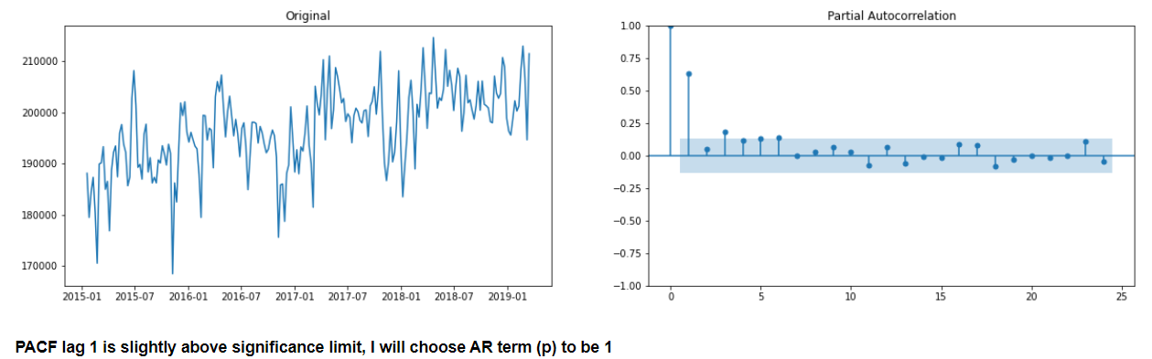
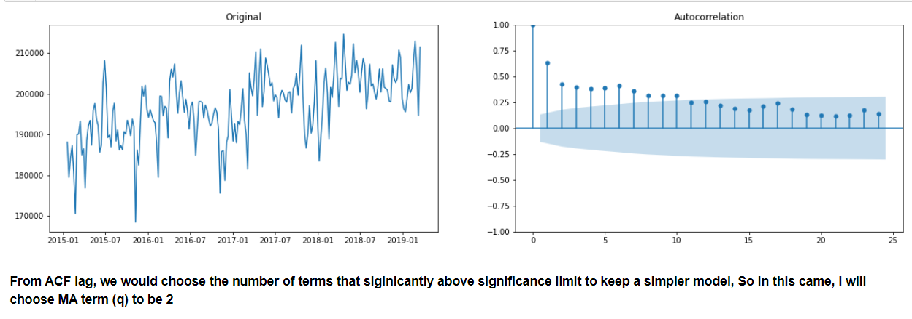

Slide 12
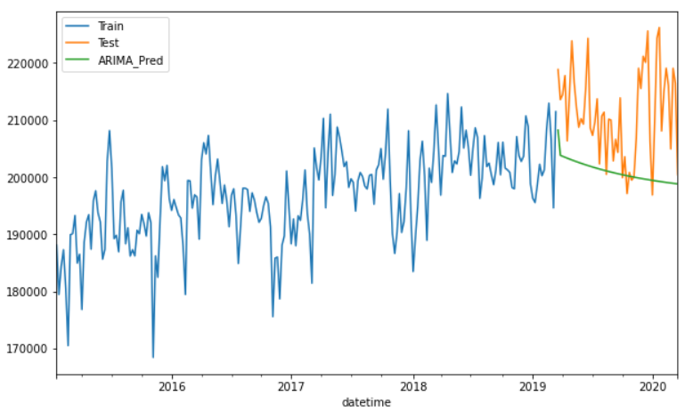
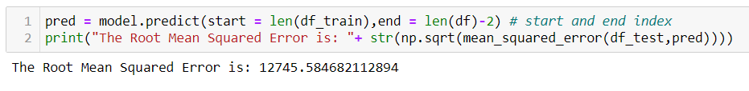
Predicting Test Dataset :

Slide 13
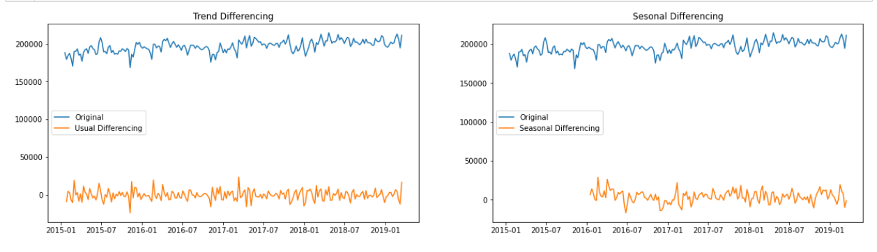
Auto ARIMA/SARIMA
The Auto ARIMA/SARIMA algorithm uses a stepwise approach to identify the best set of parameters (p,d,q) and (P,D,Q,S) for an ARIMA or SARIMA model, respectively. It starts with an initial set of parameters and iteratively tests different combinations of parameters until it identifies the set of parameters that results in the best model fit.

Slide 14
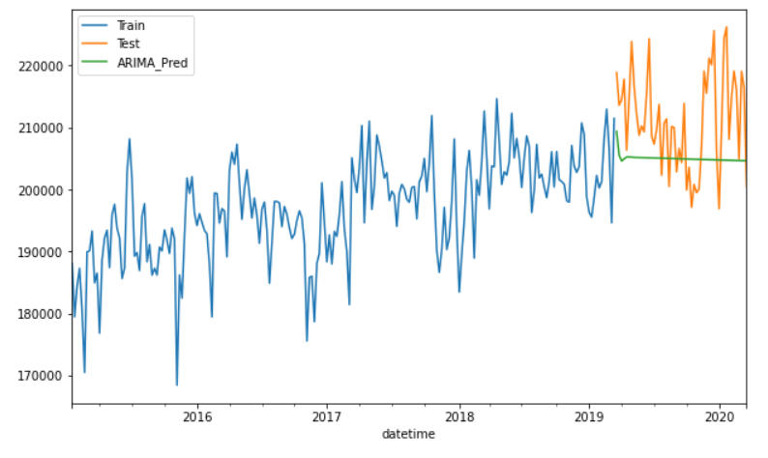
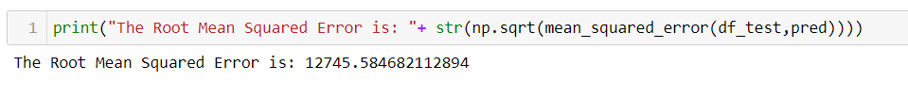
Predict the dataset :

Slide 15
Auto ARIMA with Exogenous variables
The ARIMA component of the model captures the time series patterns and trends, while the exogenous variables capture the external factors that can affect the dependent variable. The ARIMA model is determined automatically using an iterative algorithm that searches for the best parameters for the ARIMA model based on the data, while the exogenous variables are included based on their relevance and correlation with the dependent variable.

Slide 16
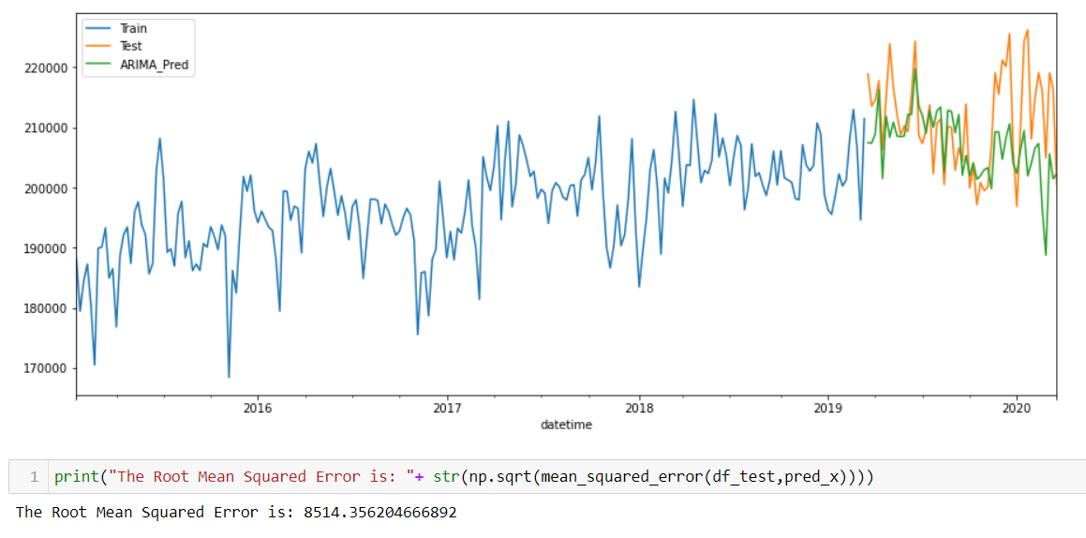
Include only those exogenous variables that are significant:

Slide 17
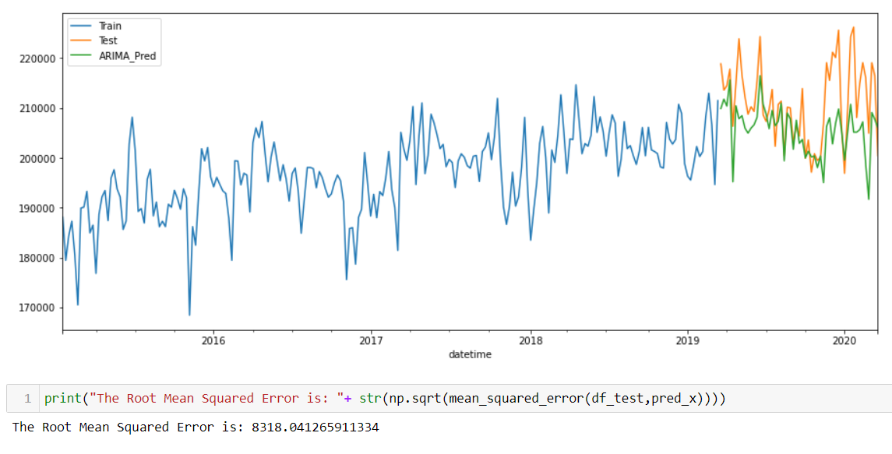
Include all exogenous variables available

Slide 18
Result & conclusion
We have used the three models, firstly using ARIMA model , the prediction was very poor. So after that we applied Auto ARIMA/SARIMA model, this model performs better than ARIMA but it is not good enough.
So at last we applied a new model Auto ARIMA with Exogenous variables, that model performs best and it is predicting the test dataset almost accurately.

Slide 19
References
S. Mishra and S. Singh, "Electric Load Forecasting using Statistical Techniques: A Survey," International Journal of Innovative Technology and Exploring Engineering, vol. 7, no. 4S, pp. 162-166, 2018.
Gheisari, M. H., Jadid, S., Shayesteh, M. G., & Soroudi, A. (2018). Electric load forecasting: A review of the literature and future research directions. International Journal of Electrical Power & Energy Systems, 98, 475-485. doi: 10.1016/j.ijepes.2017.12.016.
Chakraborty, T., Chattopadhyay, S., & Dutta, P. (2020). Electricity load forecasting using machine learning: A review. Renewable and Sustainable Energy Reviews, 132, 110093. doi: 10.1016/j.rser.2020.110093.
Khodabakhsh, S. A., & Shayesteh, M. (2016). Electricity load forecasting: Literature survey and classification of methods. Renewable and Sustainable Energy Reviews, 62, 150-168. doi: 10.1016/j.rser.2016.04.015
R. K. Singh, S. K. Singh, A. Singh, and D. P. Patil, "Electric load forecasting using deep learning: A review," Renewable and Sustainable Energy Reviews, vol. 82, pp. 2449-2468.

Slide 20
Thank You

